Slide 1


Lecture 5: Finding Features
Harbin Institute of Technology（Shenzhen）
Jingyong Su
sujingyong@hit.edu.cn

Slide 2
Outline
Local invariant features
– Motivation
– Requirements, invariances
Keypoint Localization
– Harris corner detector
Scale Invariant Keypoint Detection

Slide 3
Image matching: a challenging problem
Template
Query image

Slide 4
Image matching: a challenging problem

Slide 5
Harder Case

Slide 6
Harder Still
NASA Mars Rover Image

Slide 7
Answer Below (Look for tiny colored squares)
NASA Mars Rover images with SIFT feature matches

Slide 8
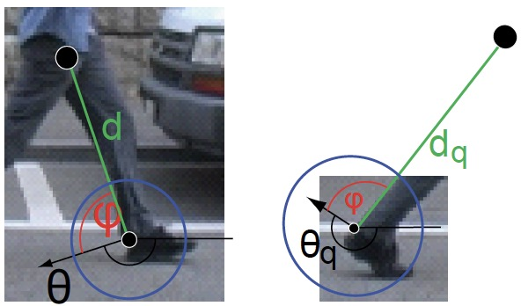
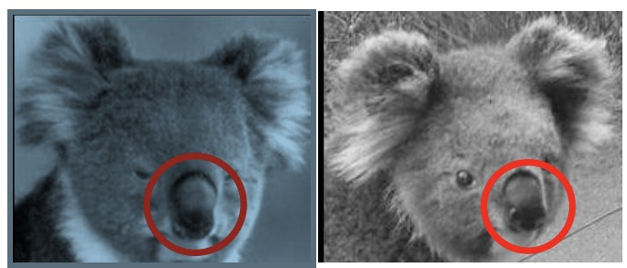
Motivation for using local features
•Global representations have major limitations. Instead, describe and match only local regions
•Increased robustness to
–Occlusions
–Articulation
–Intra-category variations

Slide 9
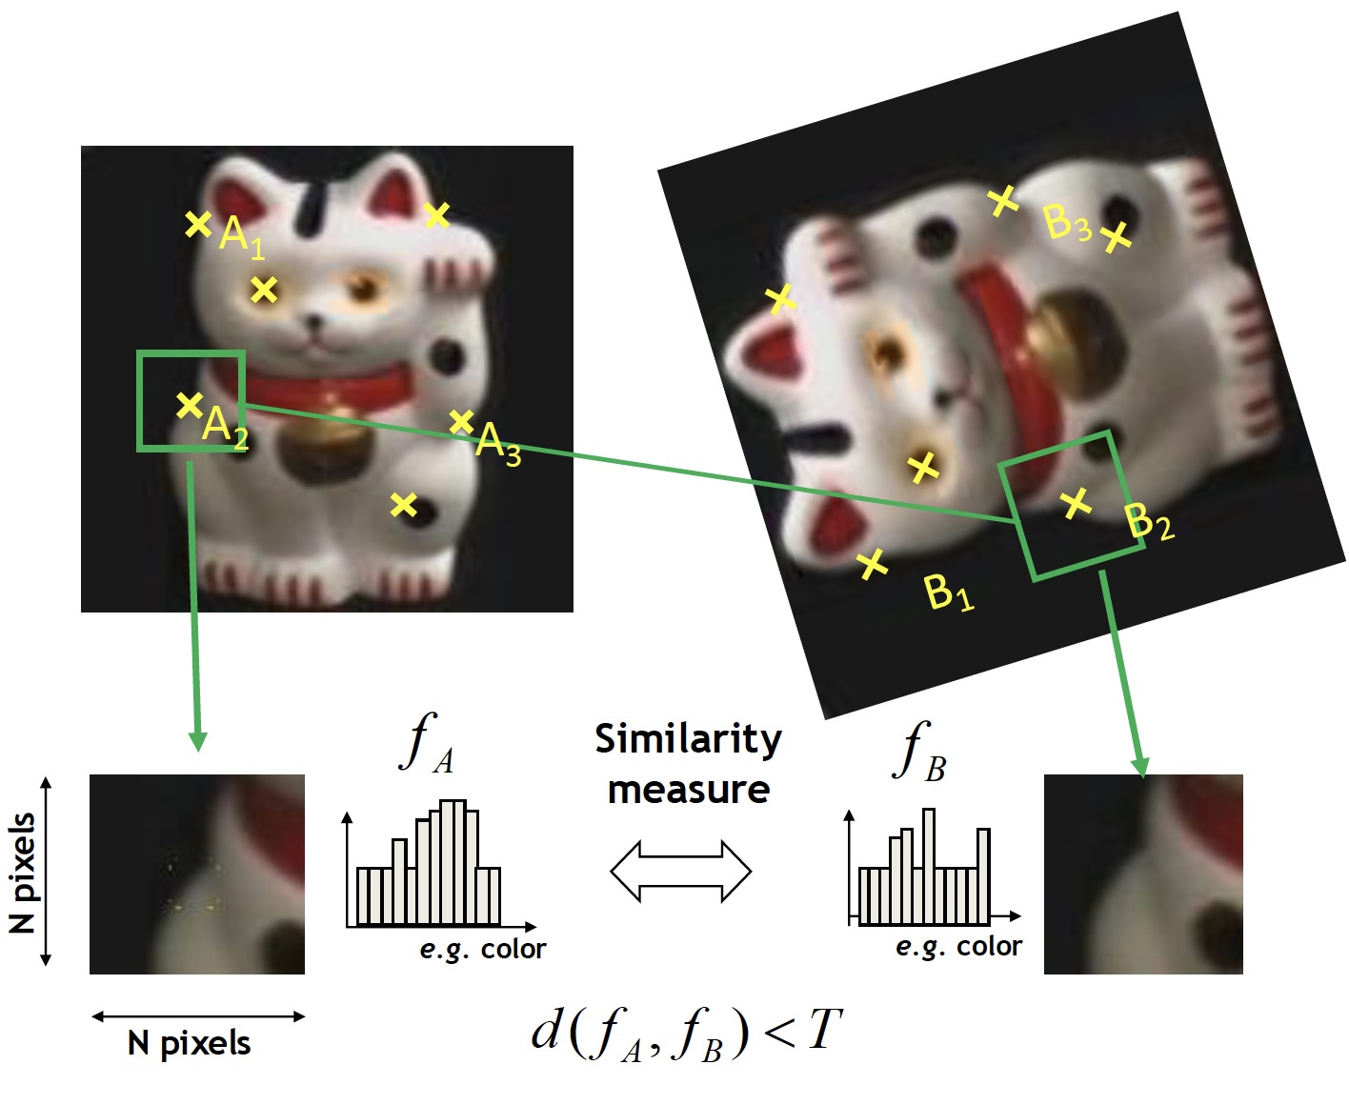
General Approach
1. Find a set of distinctive key-points
3. Extract and normalize the region content
2. Define a region around each keypoint
4. Compute a local descriptor from the normalized region
5. Match local descriptors

Slide 10
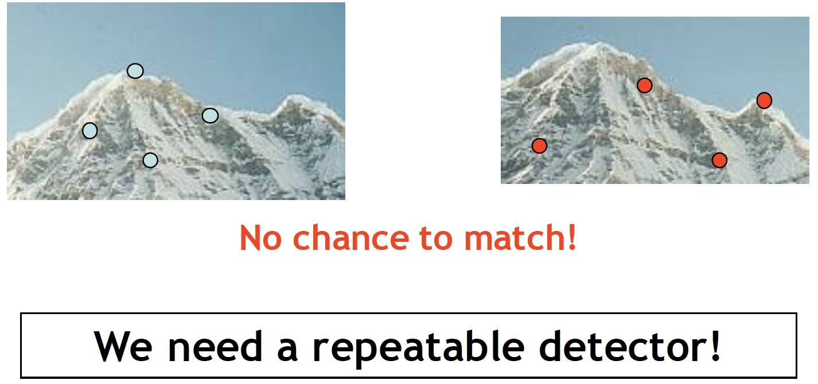
Common Requirements
•Problem 1:
–Detect the same point independently in both images

Slide 11
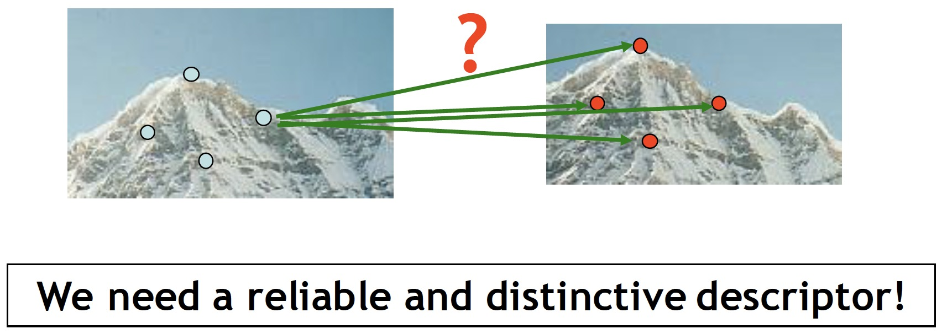
Common Requirements
•Problem 1:
–Detect the same point independently in both images
•Problem 2:
–For each point correctly recognize the corresponding one

Slide 12
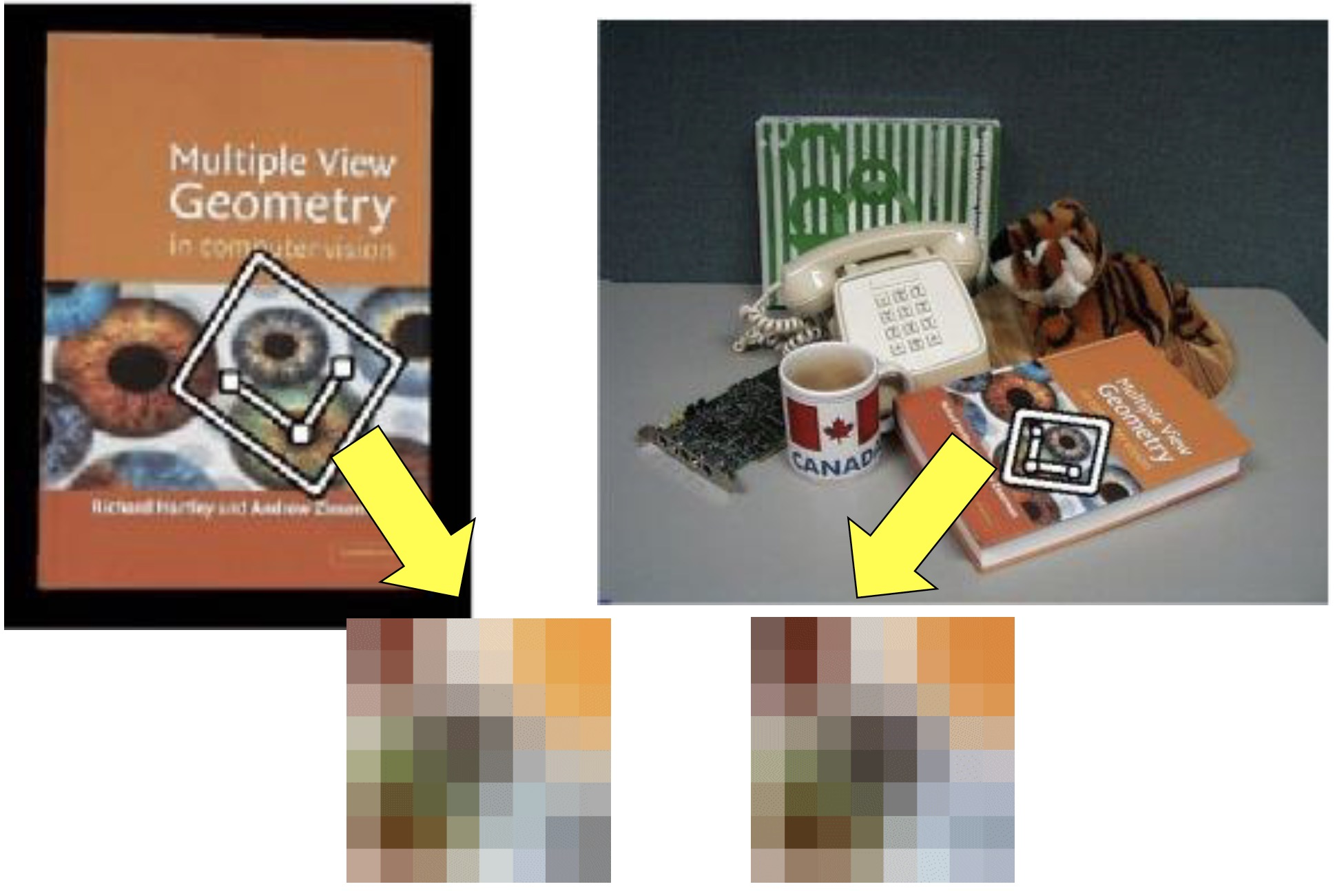
Feature Invariances: Geometric Transformations

Slide 13
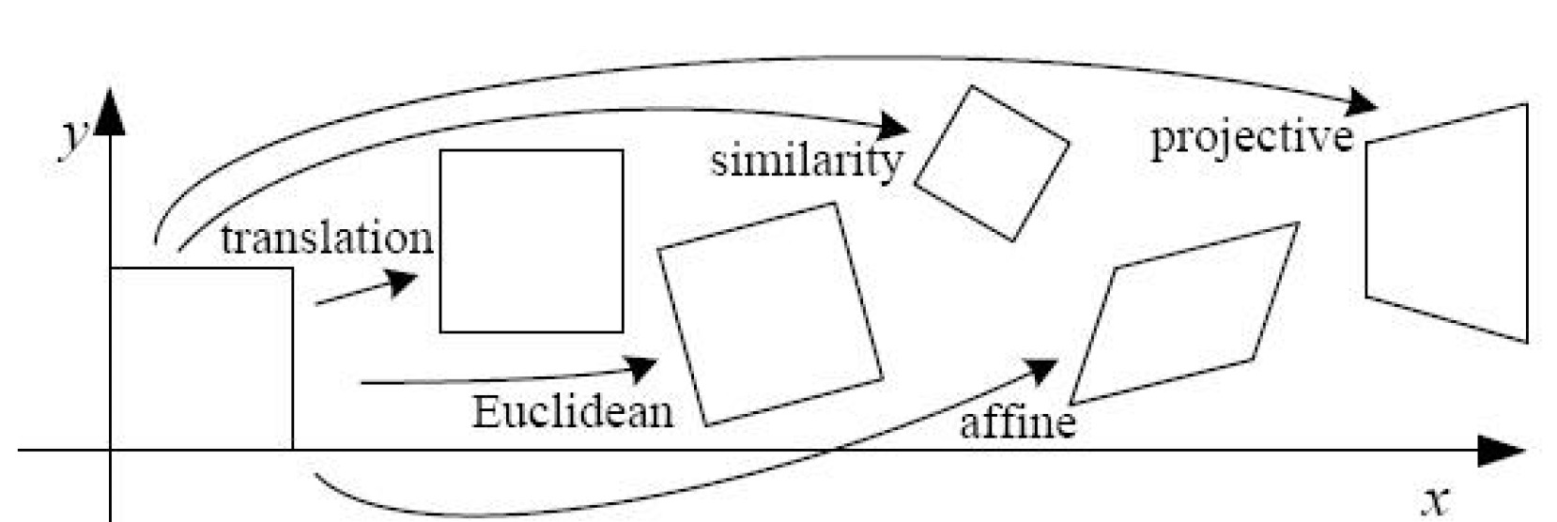
Levels of Geometric Invariance

Slide 14
Feature Invariances: Photometric Transformations

Slide 15
Requirements for Local Features
•Region extraction needs to be repeatable and accurate
–Invariant to translation, rotation, scale changes
–Robust or covariant to out-of-plane (affine) transformations
–Robust to lighting variations, noise, blur, quantization
•Locality: Features are local, therefore robust to occlusion and clutter.
•Quantity: We need a sufficient number of regions to cover the object.
•Distinctiveness: The regions should contain “interesting” structure.
•Efficiency: Close to real-time performance.

Slide 16
Many Existing Feature Detectors Available
•Hessian & Harris [Beaudet ‘78], [Harris ‘88]
•Laplacian, DoG [Lindeberg‘98], [Lowe ‘99]
•Harris-/Hessian-Laplace [Mikolajczyk& Schmid ‘01]
•Harris-/Hessian-Affine [Mikolajczyk& Schmid ‘04]
•EBR and IBR [Tuytelaars& Van Gool ‘04]
•MSER [Matas‘02]
•Salient Regions [Kadir & Brady ‘01]
•Others…
Those detectors have become a basic building block for many applications in Computer Vision.

Slide 17
Outline
Local invariant features
– Motivation
– Requirements, invariances
Keypoint Localization
– Harris corner detector
Scale Invariant Keypoint Detection

Slide 18
Keypoint Localization
Goals:
–Repeatable detection
–Precise localization
–Interesting content
Solution:
– Look for two-dimensional signal changes

Slide 19
Finding Corners
•Key property:
–In the region around a corner, the image gradient has two or more dominant directions
•Corners are repeatable and distinctive

Slide 20
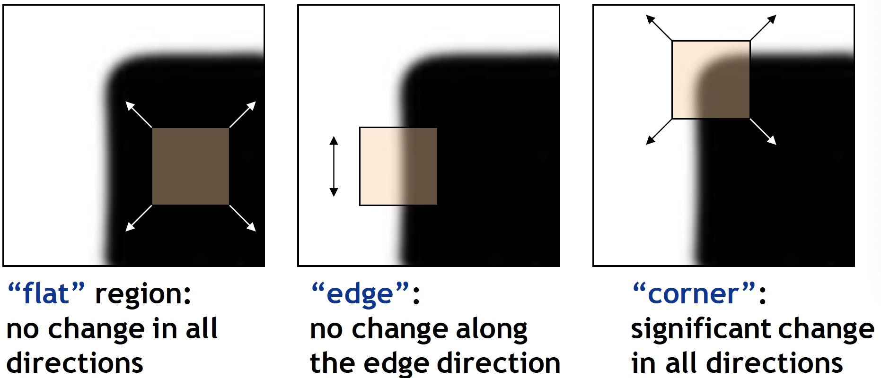
Corners as Distinctive Interest Points
•Design criteria
–We should easily recognize the corner point by looking through a small window (locality)
–Shifting the window in any direction should give a large change in intensity (good localization)

Slide 21
Harris Detector: Example

Slide 22
Harris Detector: Example
•Results are well suited for finding stereo correspondences

Slide 23
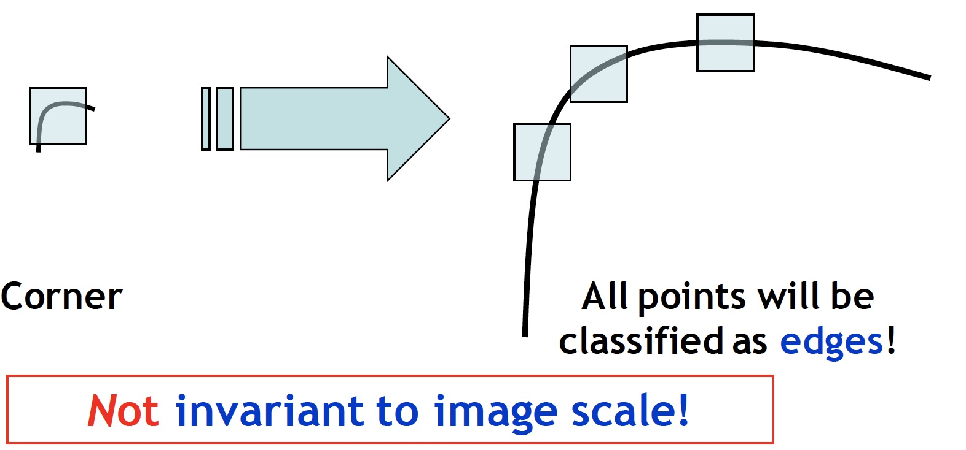
Harris Detector
– Not Invariant to Image Scale

Slide 24
Outline
Local invariant features
– Motivation
– Requirements, invariances
Keypoint Localization
– Harris corner detector
Scale Invariant Keypoint Detection

Slide 25
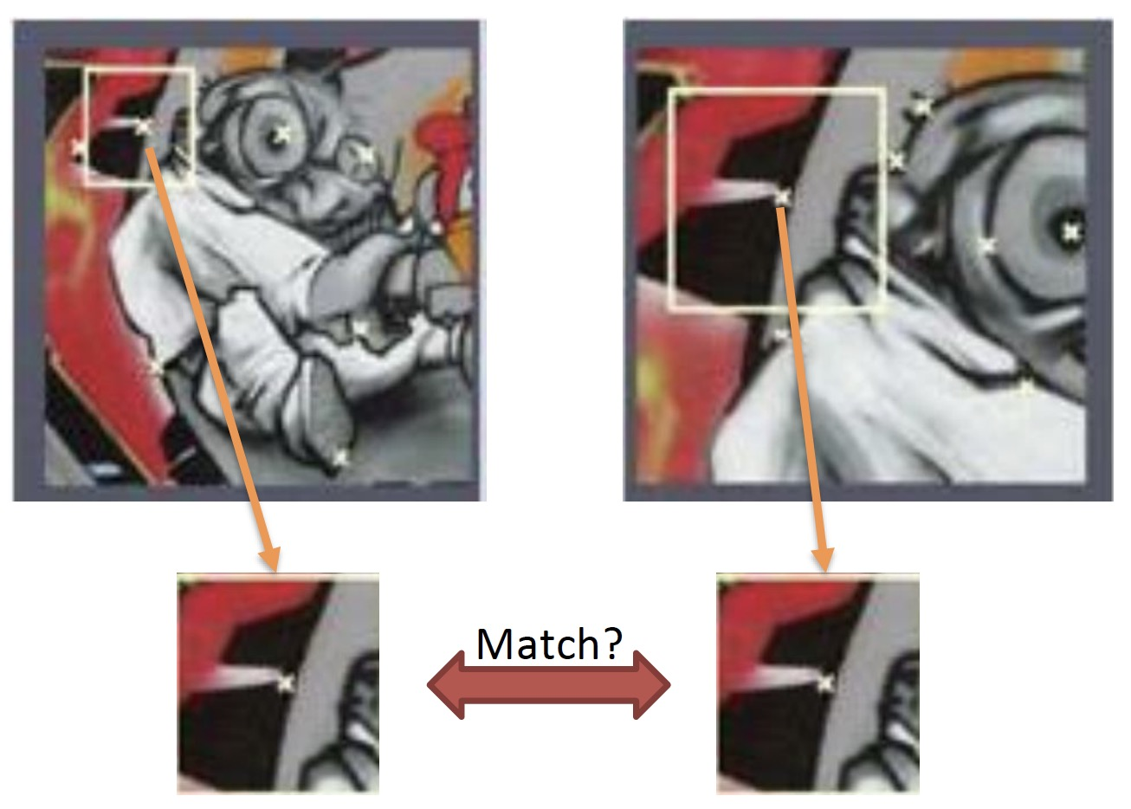
Does Scale Matter?
•For feature matching, it is important to estimate the size of the neighborhood that can lead to best matching between images of different scale.

Slide 26
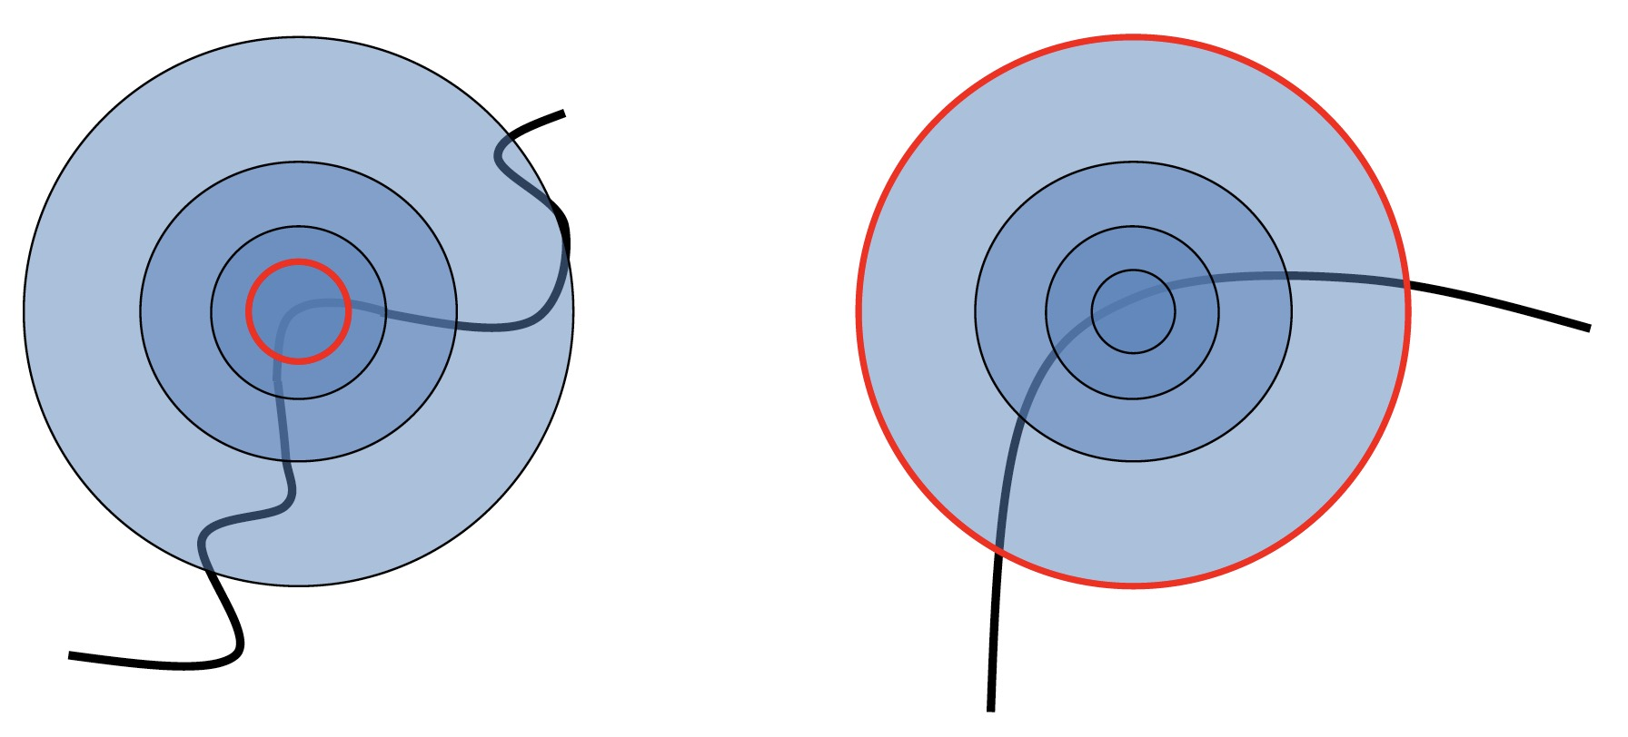
Scale Invariant Detection
•Consider regions (e.g. circles) of different sizes around a point
•What region size do we choose, so that the regions look the same in both images?

Slide 27
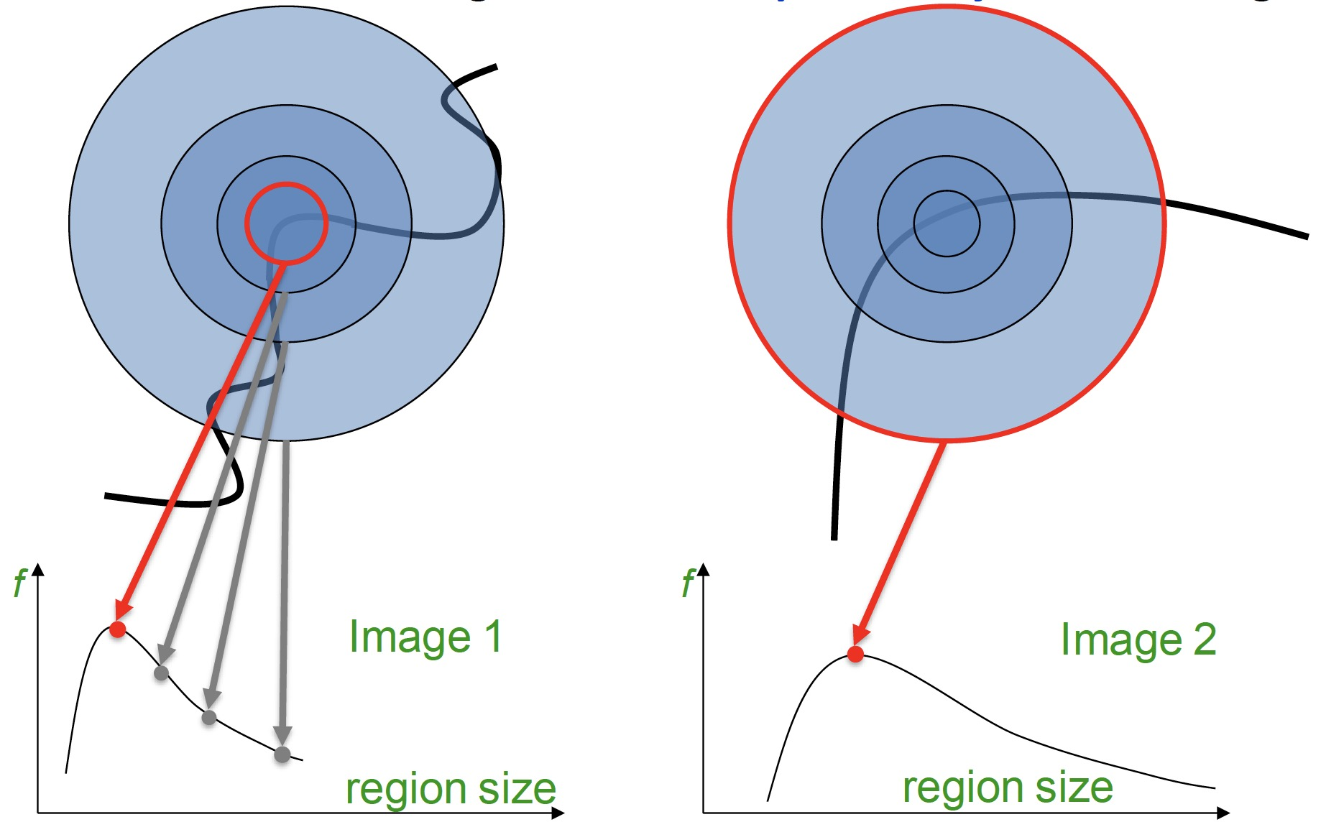
Scale Invariant Detection
•Problem: How do we choose region sizes independently in each image?

Slide 28
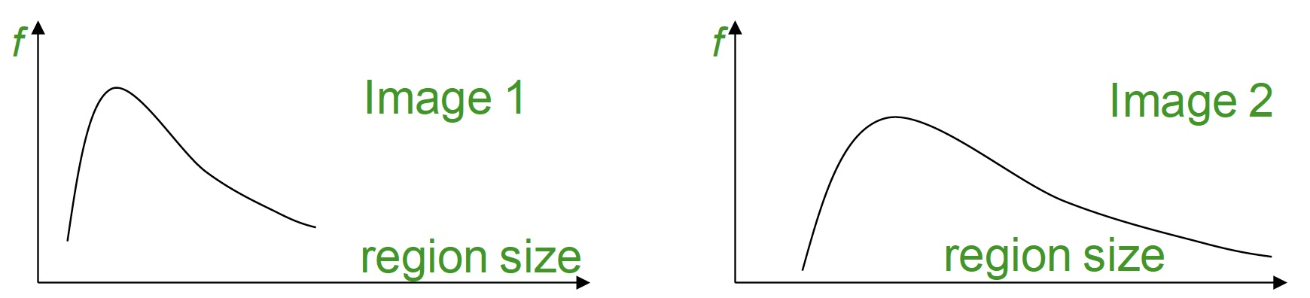
Scale Invariant Detection
•Solution:
–Design a function on the region (circle), which is “scale invariant”: has the same value for corresponding regions, even if they are at different scales
• Example: average intensity. For corresponding regions (even of different sizes) it will be the same.
–Given a point in one image, we can think of it as a function of region size (circle radius)

Slide 29
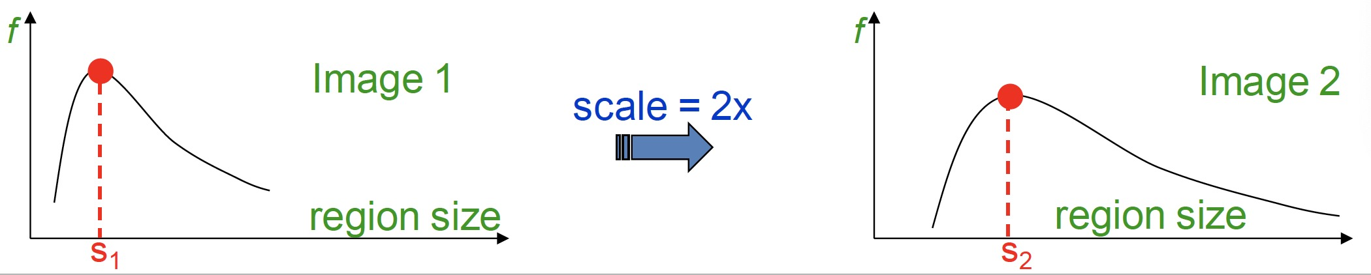
Scale Invariant Detection
•Common approach:
–Take a local maximum of this function
•Important: this scale invariant region size is found in each image independently!
•Observation: region size, for which the maximum is achieved, should be co-variant with image scale.

Slide 30
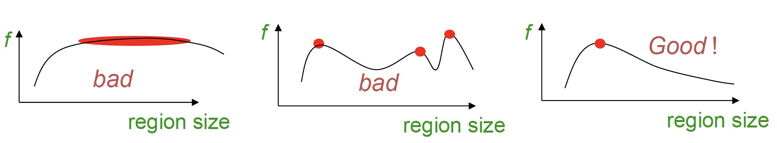
Scale Invariant Detection
• A “good” function for scale selection has one stable sharp peak
• For usual images: a good function would be one which responds to contrast (sharp local intensity change)

Slide 31
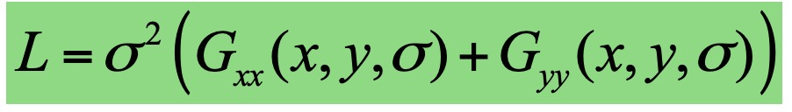
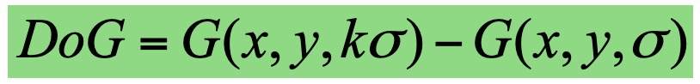
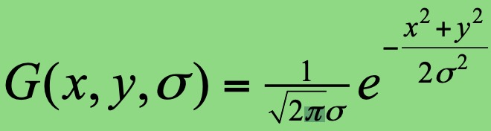
Scale Invariant Detection
•Functions for determining scale: f = Kernel * Image
• Choices of Kernels
–Laplacian:
–Difference of Gaussians (DoG):
Where G is the Gaussian function
Note: both kernels are invariant to scale and rotation

Slide 32
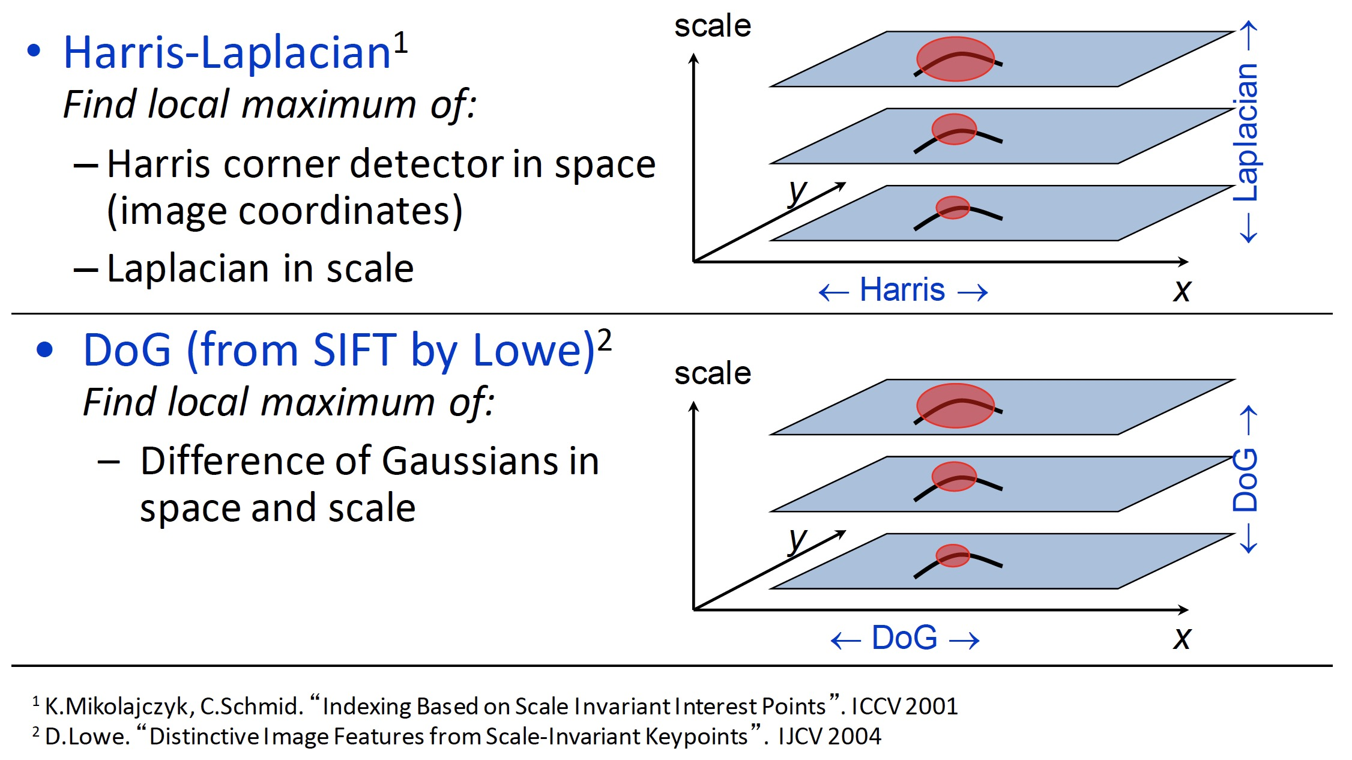
Scale Invariant Detection

